Slide 1
April 27, 2019
FAB ACE Dockerized

Slide 2
Docker Image Options for ACE and MQ
Docker Image
Docker Image
Docker Image
Integration Server
Integration Server
Integration Server
MQ Client
Local Queue Manager
MQ connectivity | Yes (HTTP API) | Yes (client binding) | Yes (server binding)
1PC for MQ | No | Yes | Yes
EDA nodes | No | No | Yes
2PC | No | No | Yes
Horizontally scalable | Yes | Yes | Yes (with loss of sequencing)
Persistent volume | Not required | Not required | Required (if durability desired)
Start up | Fast | Fast | Slower
Disk space | Smallest | Medium | Largest
2

Slide 3
Same ACE/MQ image
…but different configuration and usage
ReplicaSet “replicas=n”
StatefulSet “replicas=1”
Kubernetes Pod
Kubernetes Pod
Docker Container
Docker Container
Integration Server
Integration Server
Persistent
Volume
Local Queue Manager
Local Queue Manager
replicas = n
no persistent volume claim
HA by replication (continuous availability)
Elastic horizontally scalability
Non-durable use of EDA nodes
No 2 Phase Commit
replicas = 1
persistent volume claim
HA by reinstatement
Manual horizontal scalability
Durable use of EDA nodes
2 Phase Commit

Slide 4
Containers and pods for ACE and MQ
Pod
Pod
Pod
Container
Container
Container
Integration Server
Integration Server
Integration Server
“server” connection
(IPC)
“server”
connection
(IPC)
“client” connection
(TCP/IP)
Queue Manager
Container
Pod
Queue Manager
Requires combined ACE/MQ image – not ideal from container design point of view. Prefer to only have one core purpose/process per container.
Enables event nodes
Enables 2PC (MQ, ODBC, JMS, JDBC, CICS)
Ties topology of ACE and MQ together.
Container
Queue Manager
Standard ACE and MQ images can be used
Enables event nodes
Enables 2PC (MQ, ODBC)
Requires Docker 1.12 or later and Kubernetes 1.10 (alpha feature)
Standard ACE and MQ containers can be used
Does not enable event nodes
Does not enable 2PC
TCP/IP = Network based inter-communication
IPC = Inter Process Communication (via shared memory)

Slide 5
IBM MQ High Availability on a container platform
Single resilient queue manager
Multi-instance queue manager
Replicated data queue manager
MQ
MQ
MQ
(Stand-by)
MQ
MQ
(Stand-by)
MQ
(Stand-by)
HA
Storage
HA
Storage
Local Storage
Local Storage
Local Storage
Platform controlled resilience
Possible, but adds very little over single resilient queue manager, given the fast container recovery time.
Limitations on container cloud
Notes:
Lets use the single resilient queue manager as a starting point, where it provides fast failover in the case of a failure, only requires a single license and the load balancing is controlled by the platform removing this responsibility from MQ and the Client. Sounds like a pretty strong starting position. If we compare this with the multi-instance queue manager there are two drawbacks:
The implementation is based on specific file system requirements for the shared storage to allow the locking for the take-over by the standby. This may be acceptable in many situations, however another aspect to verify in any migration.
There are two components to manage and pay for.
Turning to the Replicated data queue manager, unfortunately it is generally not suitable for use with containers, due to the use of Linux kernel modules. In most cases, users running containers will not have sufficient access to the host server to manage kernel modules.
Therefore based on this you may want/need to consider changing your current topology towards the single resilient queue manager. Clearly this does not address the scalability aspects of your IBM MQ environment, these will be discussed in later slides.

Slide 6
Installation guidelines
https://github.com/ot4i/ace-docker
https://github.com/ibm-messaging/mq-docker

Slide 7
Supported nodes with limitations
The following message flow nodes are supported in BAR files, which will be deployed to Cloud.
AppConnectRESTRequest Filter KafkaConsumer RESTAsyncResponse TCPIPClientOutput
CallableFlowAsyncInvoke FlowOrder KafkaProducer RESTRequest TCPIPClientRequest
CallableFlowAsyncResponse HTTPAsyncRequest Label Route Throw
CallableFlowInvoke HTTPAsyncResponse Mapping RouteToLabel Trace
CallableInput HTTPHeader MQGet SOAPAsyncRequest TryCatch
CallableReply HTTPInput MQInput SOAPAsyncResponse Validate
Compute HTTPReply MQOutput SOAPEnvelope XSLTransform
Database HTTPRequest MQReply SOAPExtract
DatabaseInput Input Output SOAPInput
File JavaCompute Passthrough SOAPReply
FileInput Input ResetContentDescriptor SOAPRequest
FileOutput JavaCompute RESTAsyncRequest TCPIPClientInput
Limitations:
HTTPInput nodes and SOAPInput nodes always use HTTPS
JavaCompute node and Mapping node cannot access database or global cache

Slide 8
Unsupported nodes
Unsupported nodes
MQTT nodes .NET
JMS nodes Database Retrieve
Websphere Adapters
(PeopleSoft, SAP,
Siebel,JDE..) Database Route
Publication Fileread
Aggregation nodes FTEInput
Collector FTEOutput
Sequence/Resequence
nodes CICS
SecurityPEP Timer nodes

Slide 9
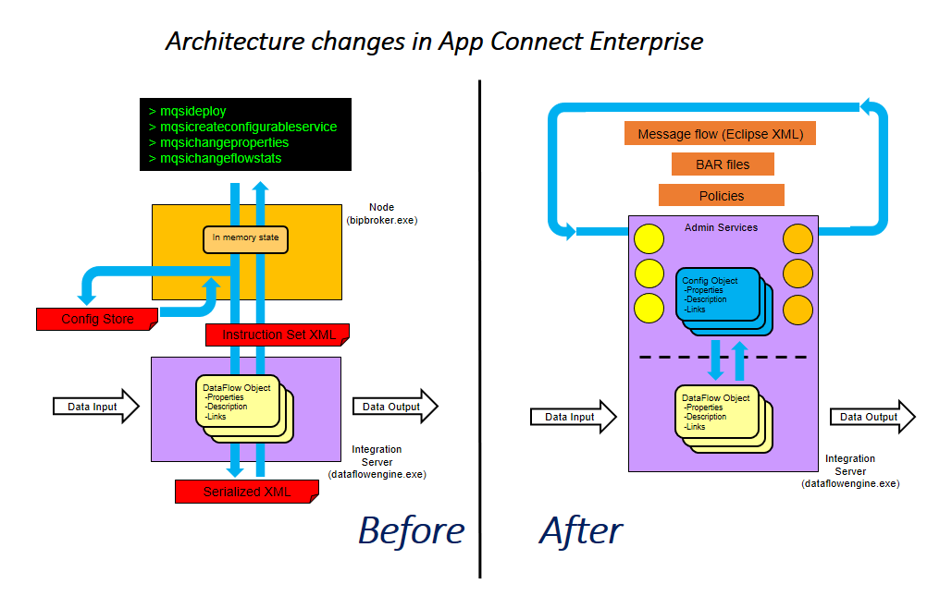
Architectural changes

Slide 10
IBM ACE Demo Slides

